Slide 1



Vermont Route 22A Truck Route Study

Slide 2
Welcome
Adam Lougee, ACRPC
Representative Diane Lanpher, Vergennes
Jeff Fritz, Vergennes

Slide 3
Agenda
Study Team
Study Overview
Summary Findings
Alternatives Analysis
Recommendations
Next Steps
Discussion

Slide 4

Study Management Team
Adam Lougee
Adam Lougee
Joe Segale
Rick Bryant

Slide 5
Agenda
Study Team
Study Overview
Summary Findings
Alternatives Analysis
Recommendations
Next Steps
Discussion

Slide 6
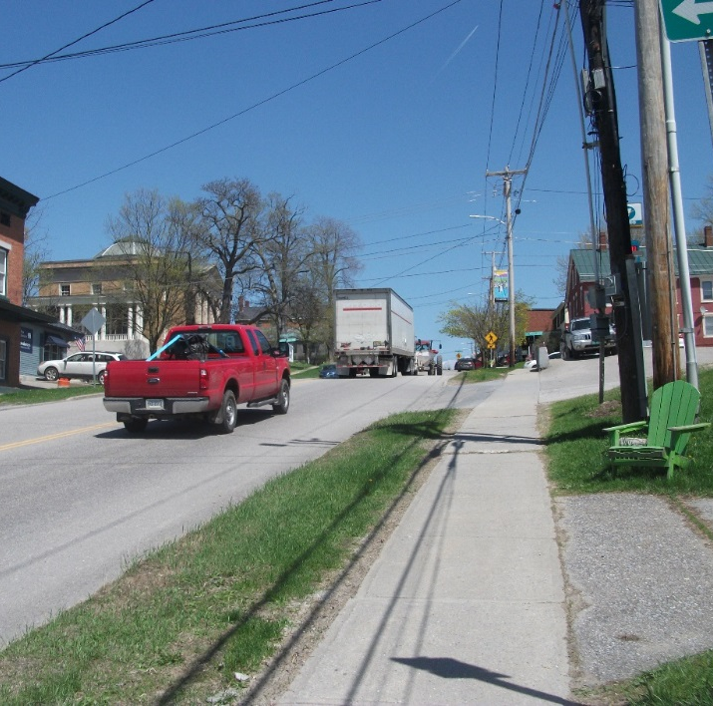
Why We’re Here
11% GRADE
HISTORIC CENTER
800 TRUCKS PER DAY
Notes:
Truck traffic must negotiate a steep grade. Historic properties are impacted.

Slide 7
Study Scope
Evaluate three strategies to enhance economic vitality and quality of life in
Downtown Vergennes…..
Notes:
This study considers three alternative actions intended to reduce the impact of trucks in Downtown Vergennes.

Slide 8
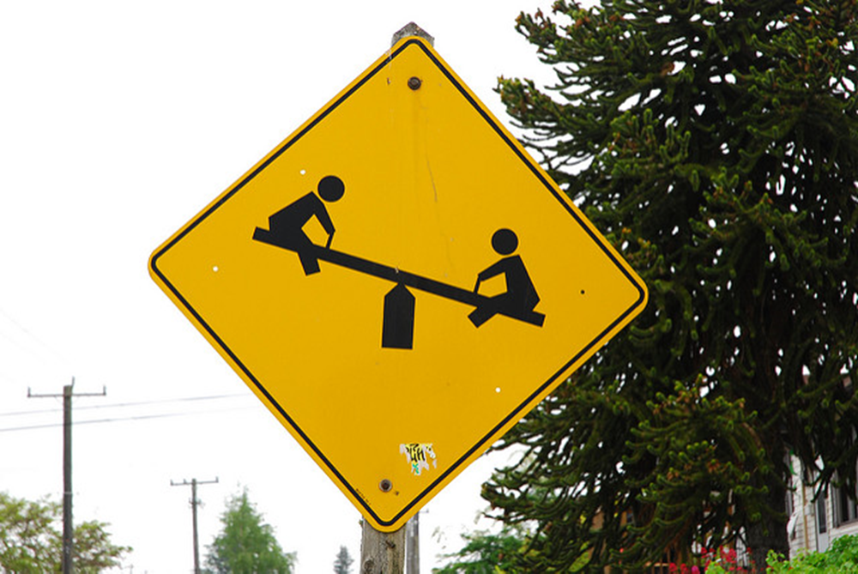
Study Scope
…. while considering impacts on neighboring communities.
Notes:
The study also considers the potential impacts on neighboring towns recognizing that a reduction in truck traffic Downtown means an increase in truck traffic elsewhere.

Slide 9

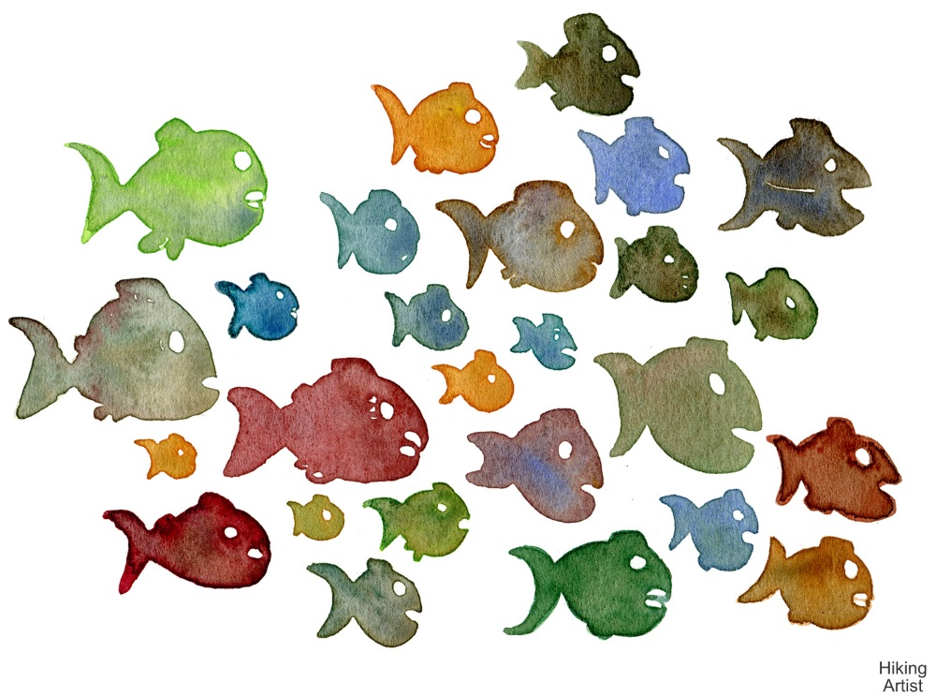
Study Goal
Build Consensus
Notes:
The primary goal of the study is to build a consensus of opinion behind one or more recommended actions. Clear and consistent direction from impacted stakeholders is critical to move a project forward and secure project funding.

Slide 10
Agenda
Study Team
Study Overview
Summary Findings
Alternatives Analysis
Recommendations
Next Steps
Discussion

Slide 11
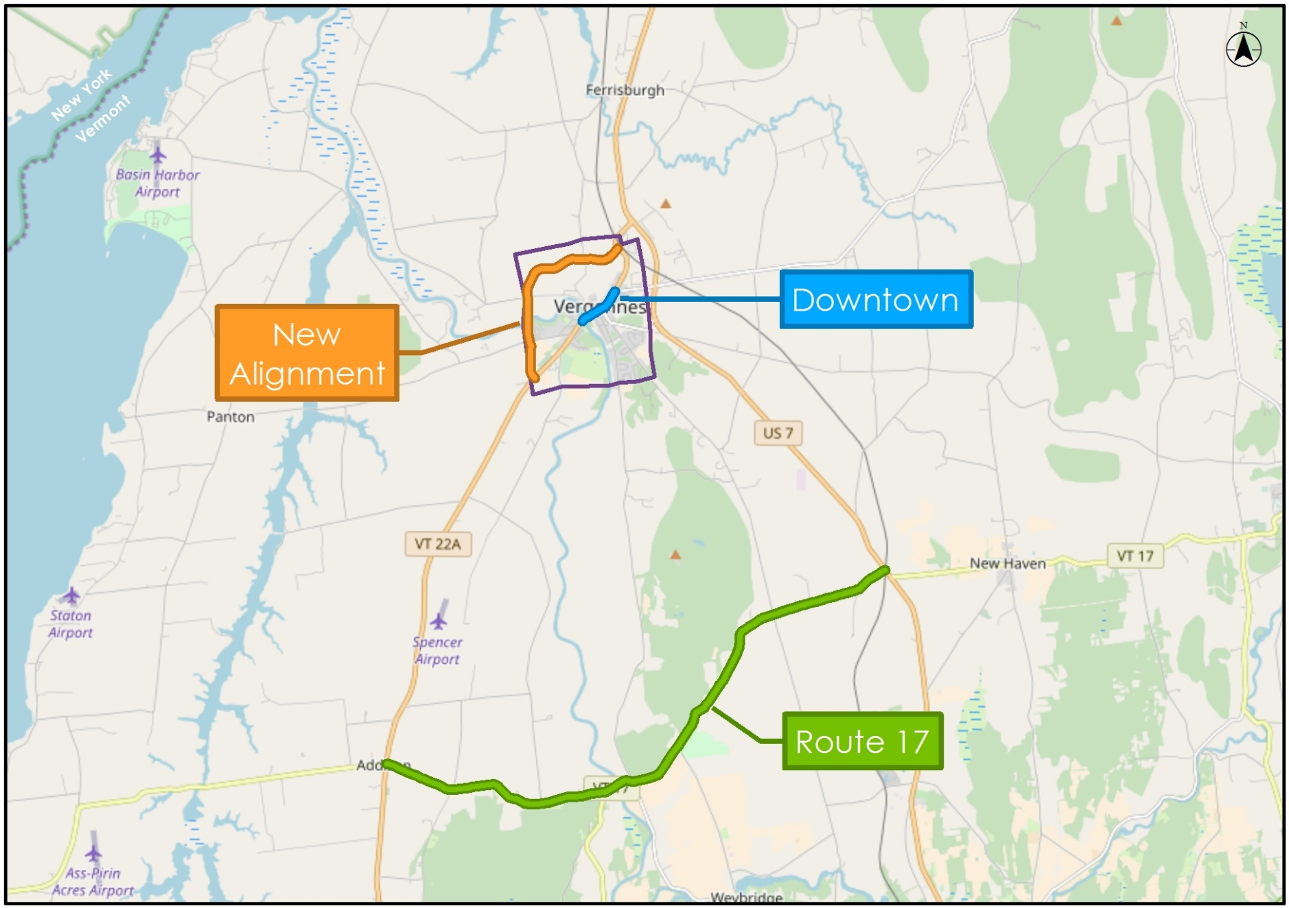
Summary Findings
“In Line”
Notes:
We prepared many slides and a lengthy draft report to explain our analyses and findings. However, before we get into the details we’re going to provide a summary of our findings and then explain the work done that led us to these findings. Again, three alternatives are under consideration. An In-Line strategy, a new roadway, and diversion of trucks to VT 17.

Slide 12
Purpose…
Freight
Other Corridors
Downtown
$
… and Need
Notes:
The three alternatives were evaluated with respect to a purpose and need statement. A version of this was just presented and a longer description is presented in our draft report. A graphic summary is shown here. Above the dashed line is our Purpose which is to enhance the vitality of Downtown Vergennes by addressing the existing truck impacts. The Needs relate to maintaining a high level of service for freight movement, minimizing and/or mitigating impacts to other corridors and efficiently expending public funds. The next three slides are color-coded, green = good, red = bad, black = neutral, to indicate how each of the three alternatives perform.

Slide 13
Alternative A
Freight
Other Corridors
Downtown
$
Notes:
Alternative A addresses the project need but does only a little to address the project purpose. We’re showing light green shading relative to the downtown benefits as it does not remove any trucks from the downtown area. It simply creates an environment where pedestrians and cyclists may be more comfortable circulating in the presence of trucks. From a Needs perspective this strategy does not have negative impacts on truck movements or other corridors. The cost of the proposed improvements are relatively minor. The economic impact and safety impacts of the project actually exceed the estimated cost, hence the dark green circle.

Slide 14
Alternative B
Freight
Other Corridors
Downtown
$
Notes:
Alternative B effectively address the project Purpose by removing all through truck traffic from downtown. It does this without significantly impacting freight transportation costs. Impacts to other corridors are slightly negative as several homes will likely need to removed from the potential new roadway ROW. Compensation for these impacts would be provided. This alternative is the most costly however it will produce positive economic impacts for Downtown Vergennes.

Slide 15
Alternative C
Freight
Other Corridors
Downtown
$
Notes:
Alternative C, the VT 17 option, also has very positive impacts for downtown Vergennes as it too would remove all through truck traffic. However, the Project Needs are not addressed. The cost to ship freight through the study area will increase more than offsetting the economic benefits to the downtown. Impacts to property owners along VT 17 would not be mitigated although they may be offset in part by benefits realized by property owners along VT 22A where trucks would be removed and reconstruction of VT 17 to provide a safer, more highly functional roadway.

Slide 16
Alternative B with New Development
Freight
Other Corridors
Downtown
$

Slide 17
Project Implementation Process
ACRPC – TAC
Build Consensus
Secure Funding
Design/Permit
Build

Slide 18
Agenda
Study Team
Study Overview
Summary Findings
Alternatives Analysis
Recommendations
Next Steps
Discussion

Slide 19
Study Alternatives
“In Line”
Notes:
We’ll now provide an explanation of the analyses that led us to these findings. Let’s begin by first defining the three alternatives are under consideration in more detail.

Slide 20
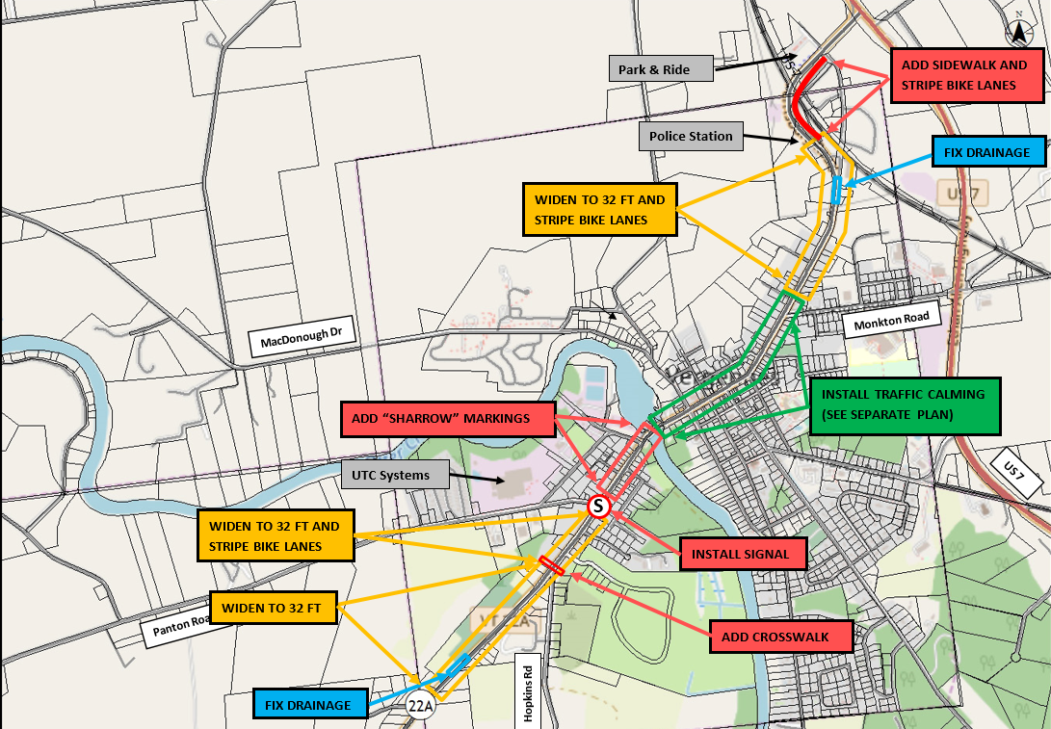
The Coolidge Residences – Site remains the same
Alt A - In Line Alternative Overview
Notes:
The In-Line alternative began as a downtown strategy involving traffic calming and streetscape improvements to create a more comfortable and safer environment for pedestrians and bicyclists. Work was initially limited to the area highligted in green on the map. Plans for these improvements are provided in te back of the room. The plan now includes other actions on the VT 22A roadway segments approaching the downtown area. Many of these actions have been identified in anticipation of a VTrans paving project scheduled for 2020. On the map, areas marked in red include pavement markings and sidewalk construction to benefit bike and pedestrian movements. Also shown in red is a new signal at Panton Road to address existing congestion issues. Yellow areas identified are considered suitable for roadway widenings to provide a shoulder for bike, pedestrians and disabled vehicles. Drainage improvements noted in blue would also be made with the roadway widenings.

Slide 21
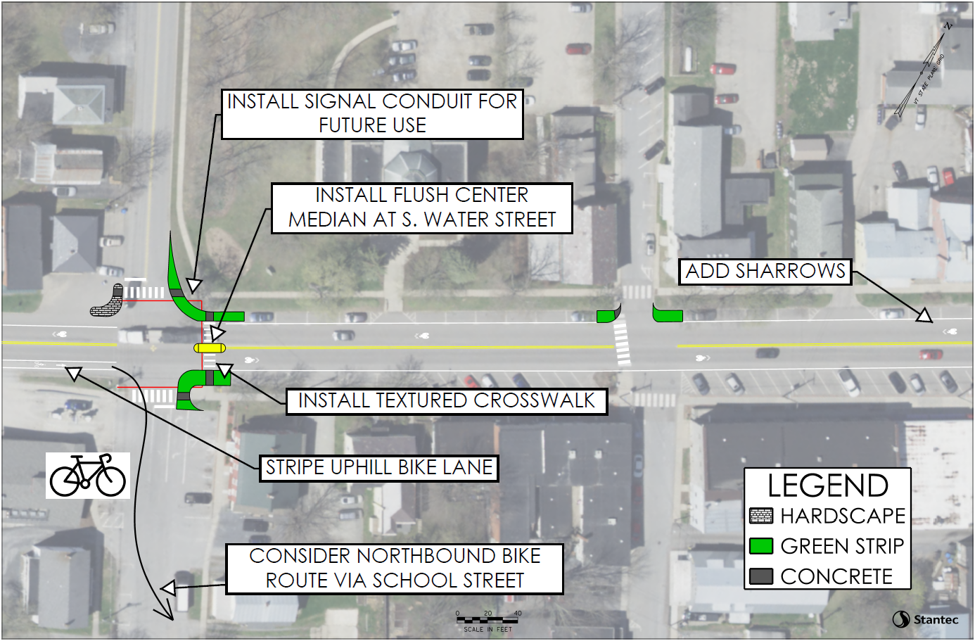
In Line Alternative - Downtown
GREEN STREET
MAIN STREET
EAST STREET
Notes:
The plan could look like this with bump-outs at intersections to shorten ped crossings, increase visibility and provide better separation between vehicles and pedestrians. New crosswalk treatments would aid circulation. Detection equipment would reduce stops by trucks.

Slide 22
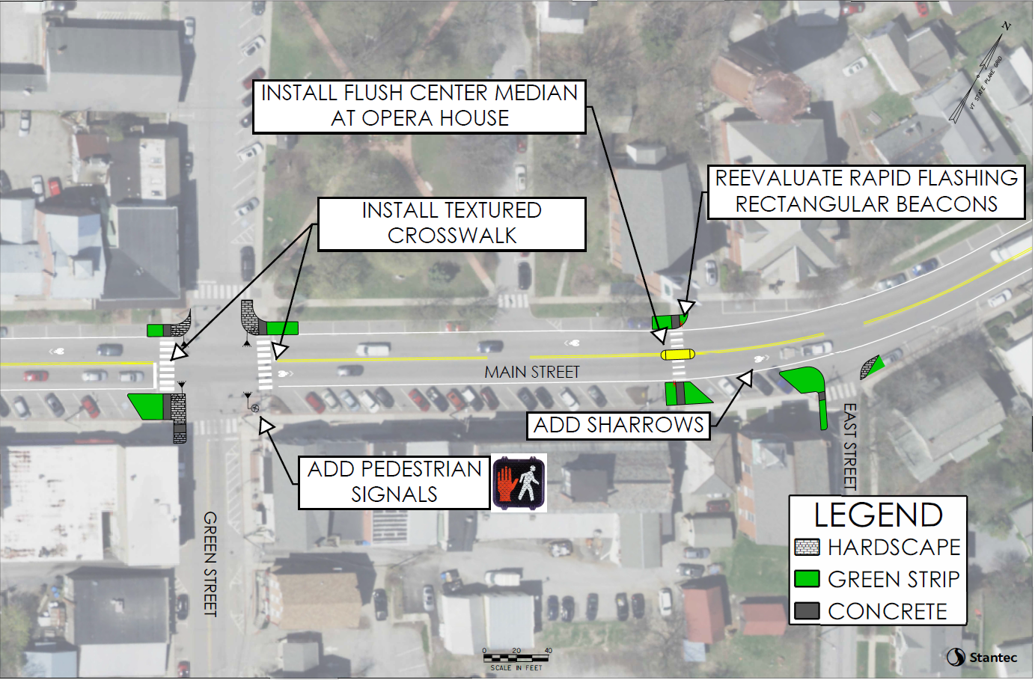
In Line Alternative - Downtown
Notes:
The plan Downtown or “on line” plan should also include continued strategies to promote rail shifting cargoes from trucks to trains. Discussions with Vermont Rail are planned.

Slide 23
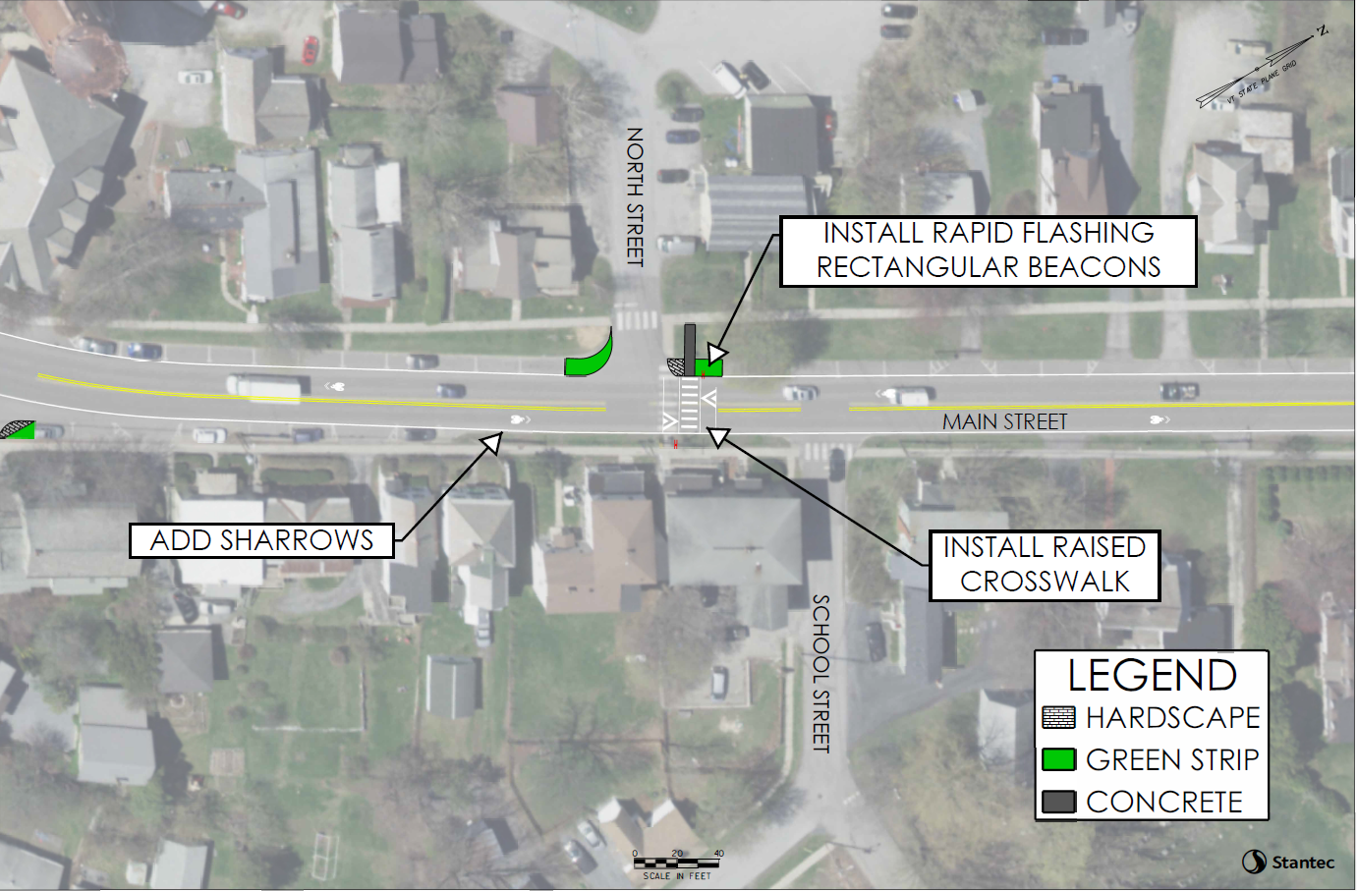
In Line Alternative - Downtown
Notes:
The plan Downtown or “on line” plan should also include continued strategies to promote rail shifting cargoes from trucks to trains. Discussions with Vermont Rail are planned.

Slide 24
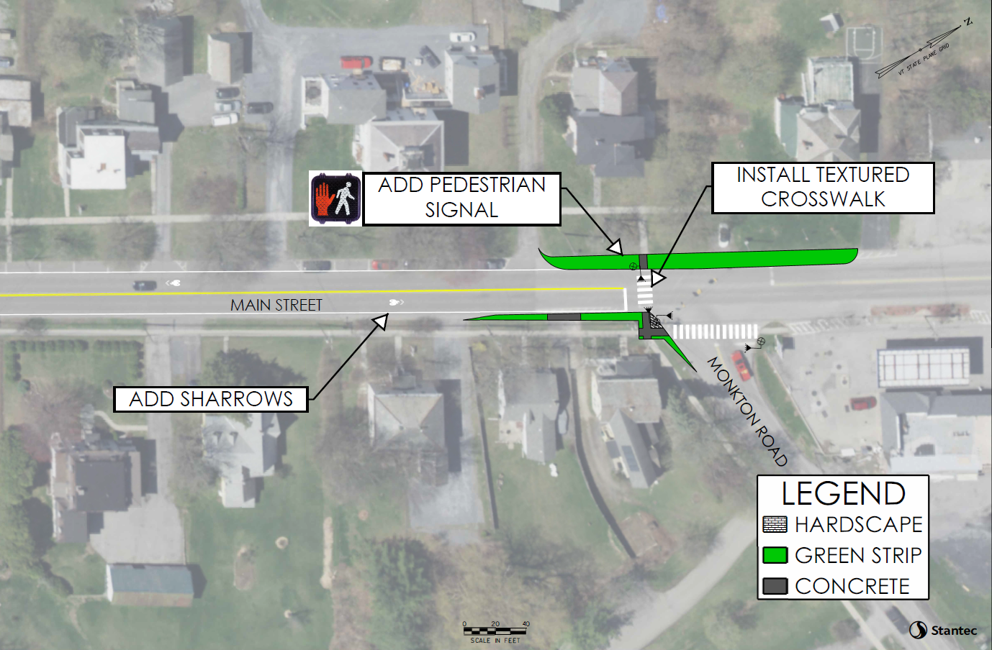
In Line Alternative - Downtown
Notes:
The plan Downtown or “on line” plan should also include continued strategies to promote rail shifting cargoes from trucks to trains. Discussions with Vermont Rail are planned.

Slide 25
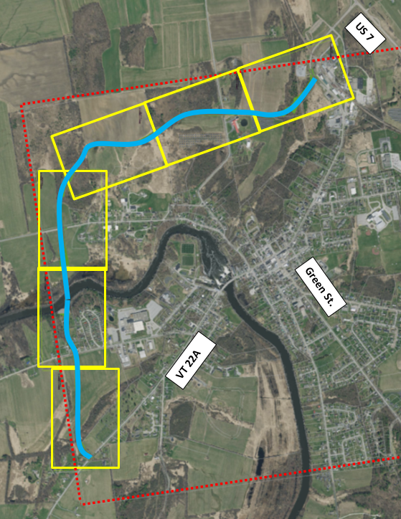
Alt B - New Alignment
32 FT Wide
45 MPH Design Speed
Notes:
The second alternative proposes construction of a new roadway circumventing Vergennes to the west and north. Trucks would be excluded from the downtown and directed to this new roadway. A possible alignment for this roadway is shown here. Plans of each of the six sections are provided in the back of the room. These drawings do not reflect a final or recommended plan. This is just a plan that we developed to aid in estimating the project construction costs and impacts. The concept does show that a roadway could be constructed entirely within the Vergennes city limits indicated by the red line on the drawing.

Slide 26
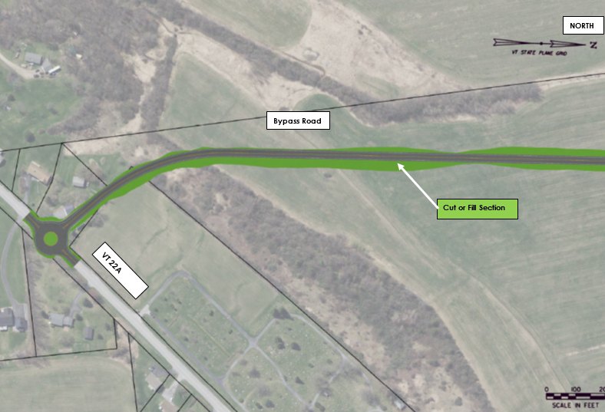
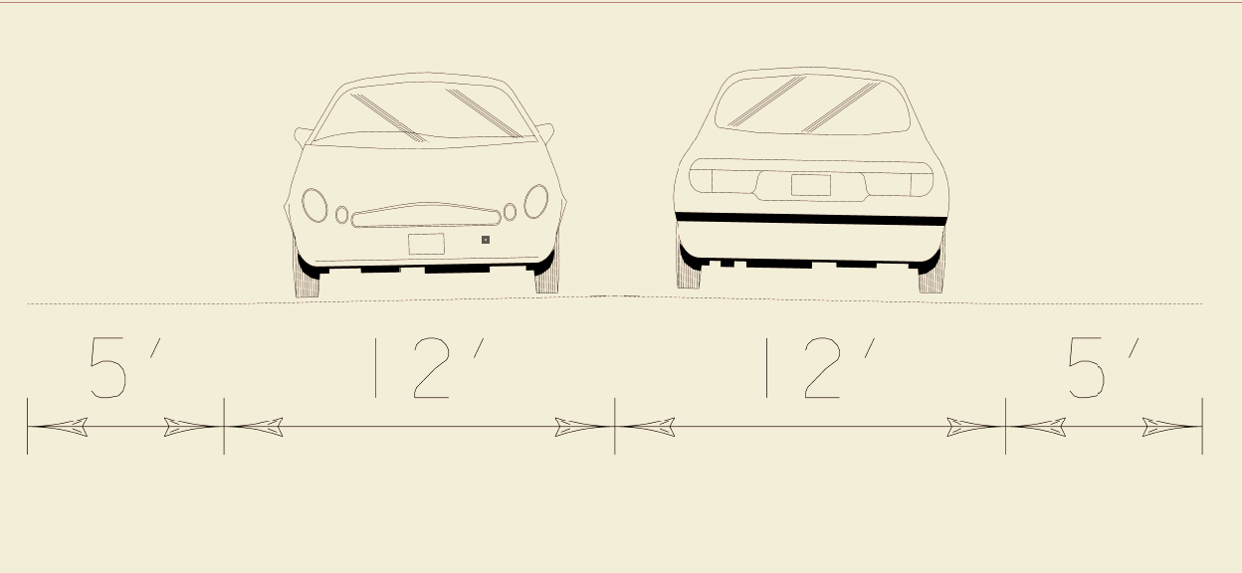
The Coolidge Residences – Site remains the same
New Alignment Plan
Notes:
Stantec has developed a computer model of a new roadway alignment. This is not the roadway that would be built. It is just a design that will be used for analysis.

Slide 27
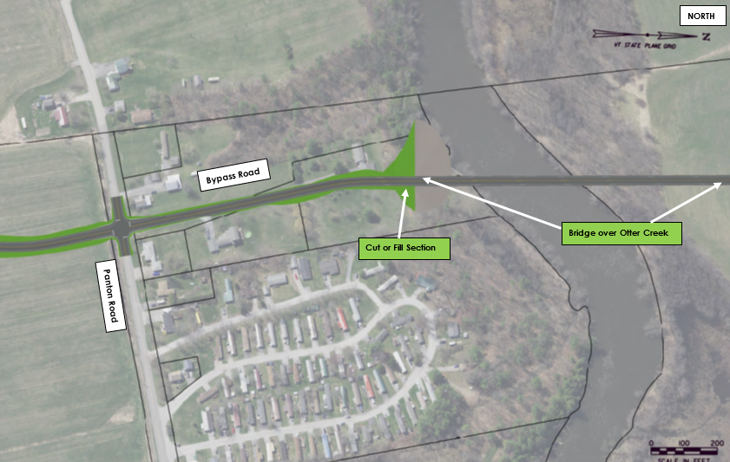
The Coolidge Residences – Site remains the same
New Alignment Plan
Notes:
Stantec has developed a computer model of a new roadway alignment. This is not the roadway that would be built. It is just a design that will be used for analysis.

Slide 28
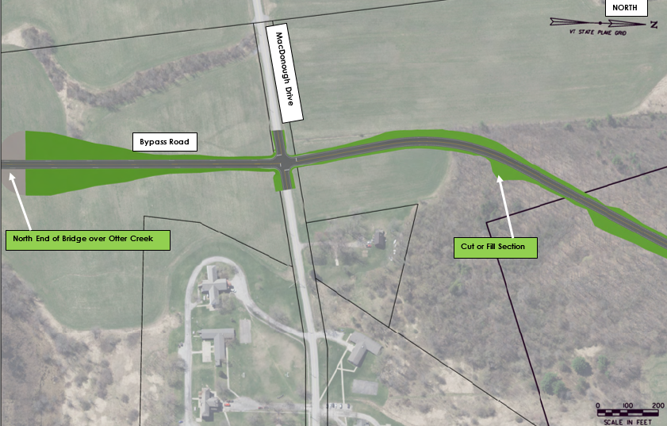
The Coolidge Residences – Site remains the same
New Alignment Plan
Notes:
Stantec has developed a computer model of a new roadway alignment. This is not the roadway that would be built. It is just a design that will be used for analysis.

Slide 29
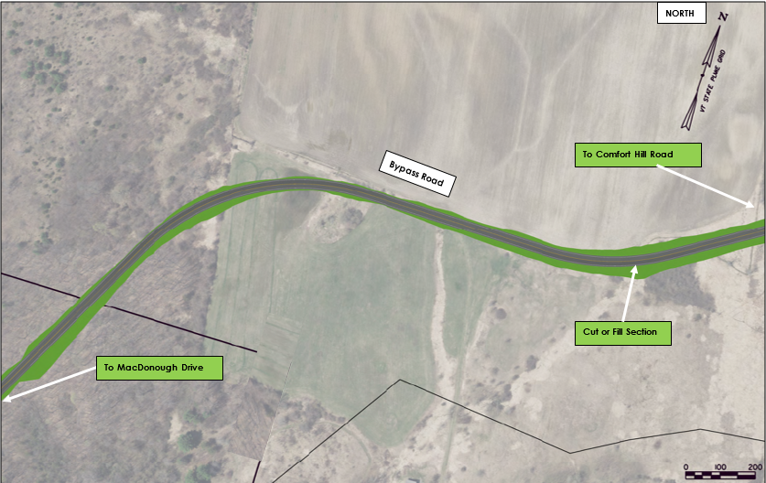
The Coolidge Residences – Site remains the same
New Alignment Plan
Notes:
Stantec has developed a computer model of a new roadway alignment. This is not the roadway that would be built. It is just a design that will be used for analysis.

Slide 30
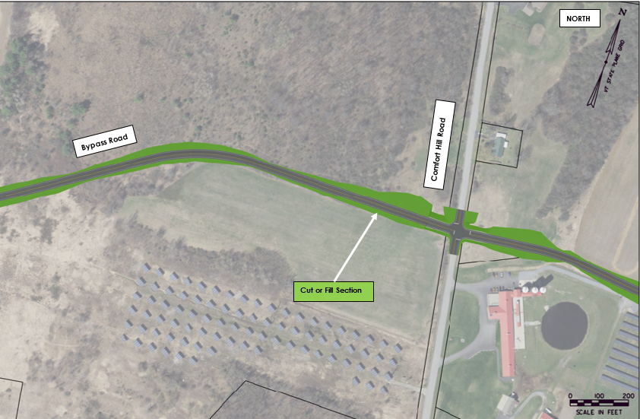
The Coolidge Residences – Site remains the same
New Alignment Plan
Notes:
Stantec has developed a computer model of a new roadway alignment. This is not the roadway that would be built. It is just a design that will be used for analysis.

Slide 31
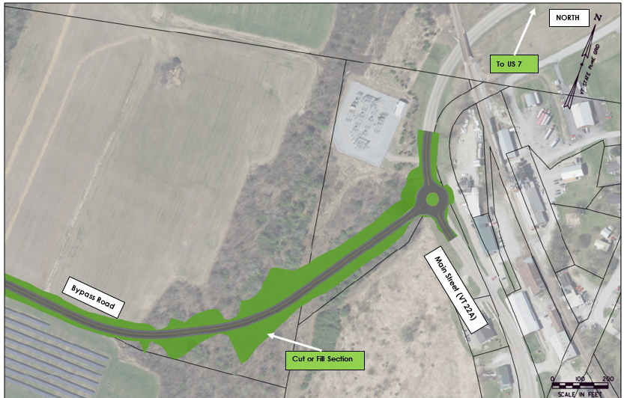
The Coolidge Residences – Site remains the same
New Alignment Plan
Notes:
Stantec has developed a computer model of a new roadway alignment. This is not the roadway that would be built. It is just a design that will be used for analysis.

Slide 32
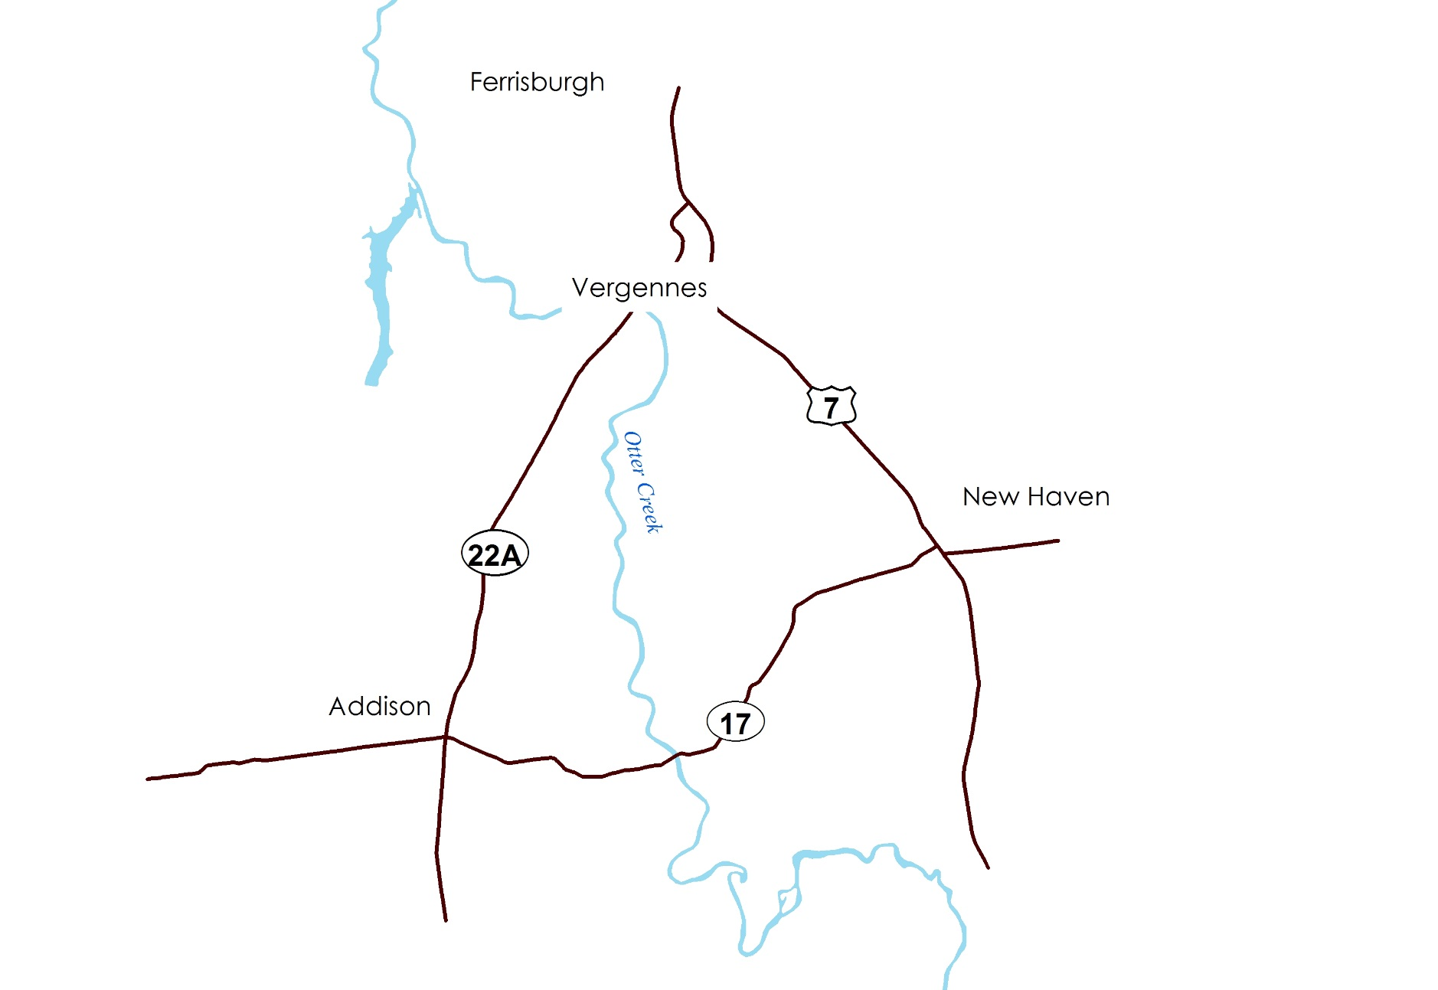

Alt C – VT Route 17 Alternative
NO THROUGH TRUCKS
Notes:
The third option would also exclude through trucks from downtown directing them to VT 17. VT 17 would be upgraded as appropriate to accommodate these trucks.

Slide 33
VT 17 Design Objectives
Notes:
Upgrades proposed for VT 17 are intended to make it suitable for truck traffic. In this regard, the roadway width would be increased from an existing condition of 24 to 26 feet to a minimum width of 32 feet. Horizontal and vertical curves would be realigned to meet a 50 mph design speed. Multiple locations have advisory speeds under 45 mph under existing conditions.

Slide 34
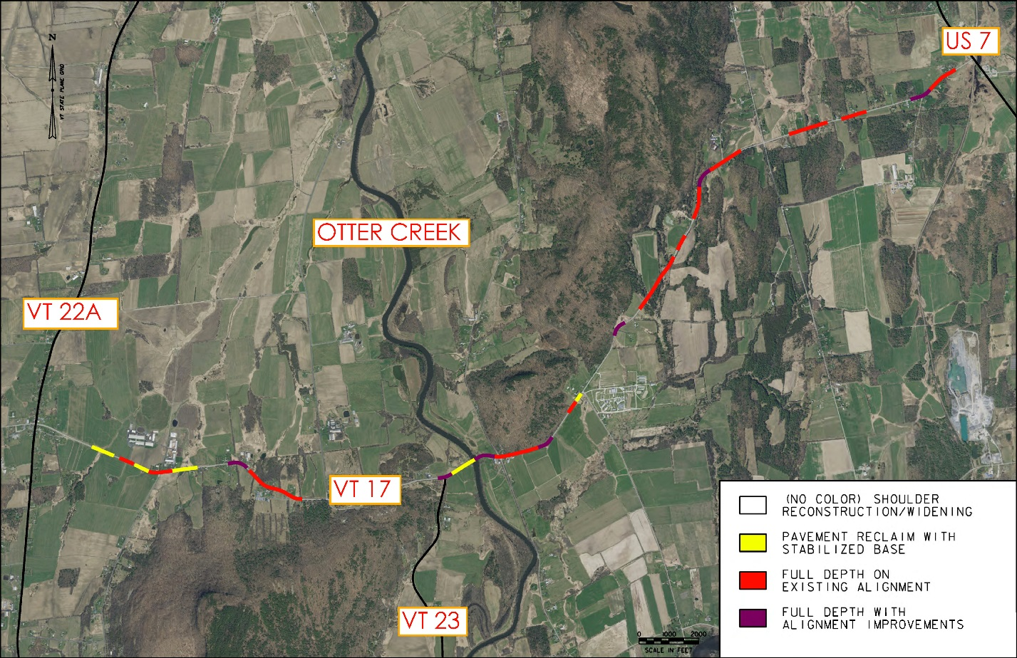
VT 17 Alternative
HALLOCK RD
VT ROUTE 17
VT ROUTE 17
QUAKER VILLAGE RD
Notes:
This plan color codes roadway segments by proposed treatments deemed necessary to address existing alignment issues along the roadway affecting operations and safety. A wkidening to 32 feet is proposed for the entire length of the segment between VT 22A and US 7. Sections requiring significant reconstruction and alignment changes are highlighted in purple..

Slide 35
VT 17/US 7 Intersection
Notes:
Upgrades proposed for VT 17 are intended to make it suitable for truck traffic. In this regard, the roadway width would be increased from an existing condition of 24 to 26 feet to a minimum width of 32 feet. Horizontal and vertical curves would be realigned to meet a 50 mph design speed. Multiple locations have advisory speeds under 45 mph under existing conditions.

Slide 36
Alternatives Evaluation
Feasibility
Implementation Cost
Benefits/Impacts
Notes:
For each alternative action Stantec determined its feasibility, cost and potential impacts. We’ll go through each of these general categories now.

Slide 37
Feasibility
Traffic Operations
Permitting
Time Frame
Notes:
From a feasibility perspective we wanted to determine if each alternative action can adequately serve future peak hour traffic demands. We also wanted to know if there were permit issues that would preclude its implementation. Finally, we looked at the permitting process and other factors to understand how long it would take to implement each plan.

Slide 38
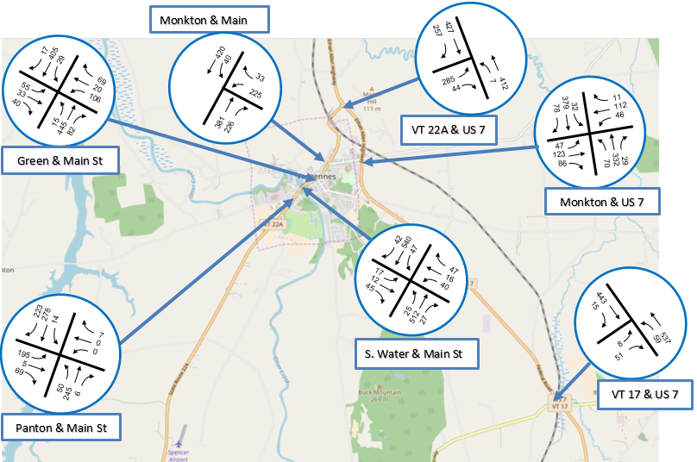
Traffic Forecasts (PM Peak Hour)
Notes:
For each alternative action Stantec will need to refine the concept considering existing constraints.
Stantec will also determine the feasibility of each alternative and look at the time frames to develop each alternative.
Finally, a cost-benefit analysis will be prepared for each alternative. The results would be used to compare these proposals to one another and to other transportation projects competing for state funding.

Slide 39
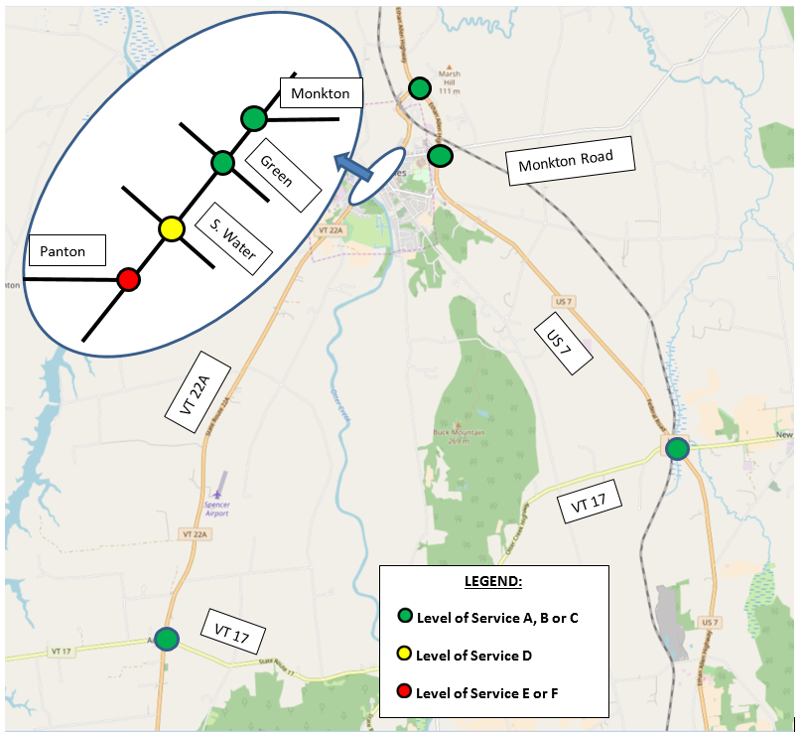
Traffic Operations
Notes:
From a traffic operations perspective we projected future traffic demands based on VTrans growth rates for truck and non-truck traffic and based on traffic reassignments associated with each alternative as appropriate. We then calculated intersection operating levels of service for each intersection based on its geometry and traffic control conditions. Results are shown here with problem areas shown in red (indicating E or F operations on a scale of A to F). As shown, the roadway system has adequate capacity to accommodate future growth except for the Panton Road/Main Street intersection which could benefit from traffic signal control under existing conditions.

Slide 40
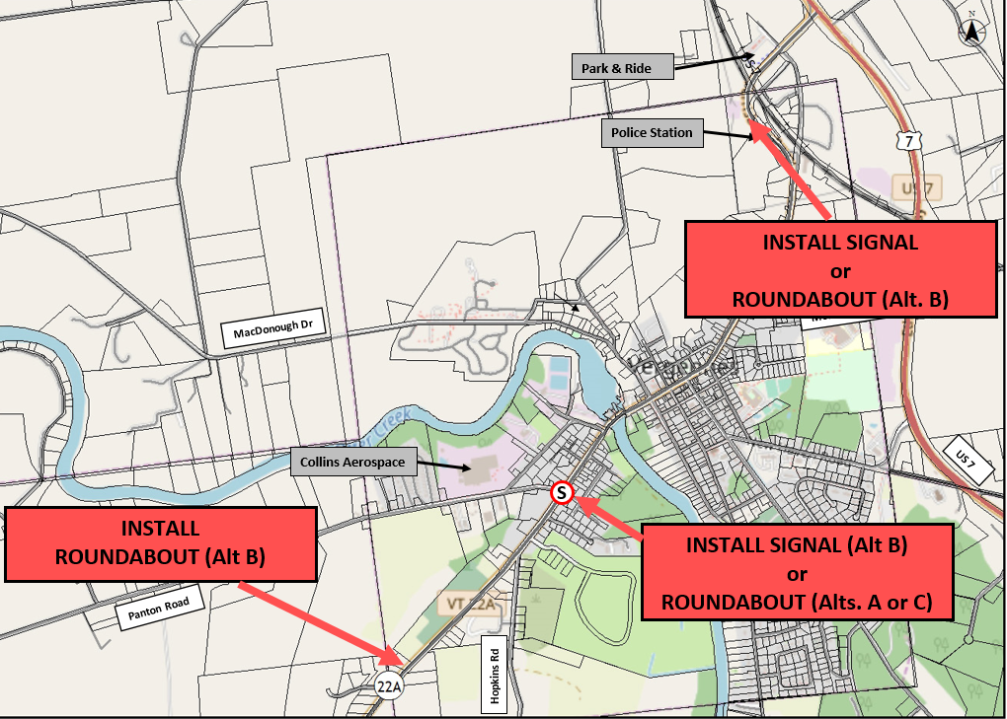
Traffic Mitigation
Notes:
For each alternative action Stantec will need to refine the concept considering existing constraints.
Stantec will also determine the feasibility of each alternative and look at the time frames to develop each alternative.
Finally, a cost-benefit analysis will be prepared for each alternative. The results would be used to compare these proposals to one another and to other transportation projects competing for state funding.

Slide 41
Permitting
Resource | Alt A (In Line) | Alt B (New Alignment)* | Alt C (VT 17)**
Wetlands/ Floodplain | Minor | Major | Minor
Historic Cultural Resources | Minor | None | Minor
Prime Ag Soils | None | Major | Minor
Wildlife Habitat | None | Minor | Minor
* Act 250 and NEPA EIS Expected
**Act 250 and NEPA Categorical Exclusion Expected
Notes:
From a permitting perspective we considered four resource areas:
Wetlands/floodplain
Historic and Cultural
Prime Ag Soils, and
Wildlife habitat
Represented by the four rows in the table.
The three alternatives are represented by the three columns. Left to right you see that Alt A has the fewest permit issues. Work is generally proposed within the existing highway layout such that none of the resource categories are significantly impacted. Here again, green and red are used to illustrate relative impacts. Alt B impacts undeveloped land and involves a roadway crossing of the Otter Creek. Wetland/floodplain impacts must be addressed for the river crossing and the new roadway may cross prime ag soils. For the most part, work on Alt C is also within the existing roadway ROW. Impacts will be greater than those for Alt A but not as significant as those for Alt B.
or each alternative action Stantec will need to refine the concept considering existing constraints.
Stantec will also determine the feasibility of each alternative and look at the time frames to develop each alternative.
Finally, a cost-benefit analysis will be prepared for each alternative. The results would be used to compare these proposals to one another and to other transportation projects competing for state funding.

Slide 42
Time Frame (once funded)
Notes:
From a timing perspective, the Alt A work could be completed within four years of funding approval. Again, this relates to the limited permitting and ROW impacts. Alts B and C are both of a scale that design, permitting and construction would require 8 to 10 years to complete.
Portions of Alt A may be completed by 2020 as part of the scheduled paving project. VTrans indicates that funding for large scale projects such as B and C is committed for the next five years.

Slide 43
Implementation Cost
Construction
Right-of-way
Design and Permitting
Notes:
Implementation costs for each alternative action were developed by considering three components.: construction, ROW and D&P.

Slide 44
Implementation Cost
Resource | Alt A (In Line) | Alt B (New Alignment) | Alt C (VT 17)
Construction | $1.4 Million | $28 Million | $17 Million
Right-of Way | Minor | $2 Million | Some
Design & Permitting | $0.5 Million | $9 Million | $6 Million
Total | $1.9 Million | $39 Million | $23 Million
Notes:
As expected, Alt A is the low cost option at approximately $2 million. Alt B is the most expensive at almost $40 million. Alt C at $23 million is not quite as expensive as B but would still be viewed as a large project by VTrans.

Slide 45
Benefits/Impacts
Safety/Crash Reduction
Operational Costs
Quality of Life
  Downtown
  Elsewhere
Economic Development
Notes:
Of course, the big question is “what do you get for your money?” We examined a number of categories to understand project benefits and impacts.

Slide 46
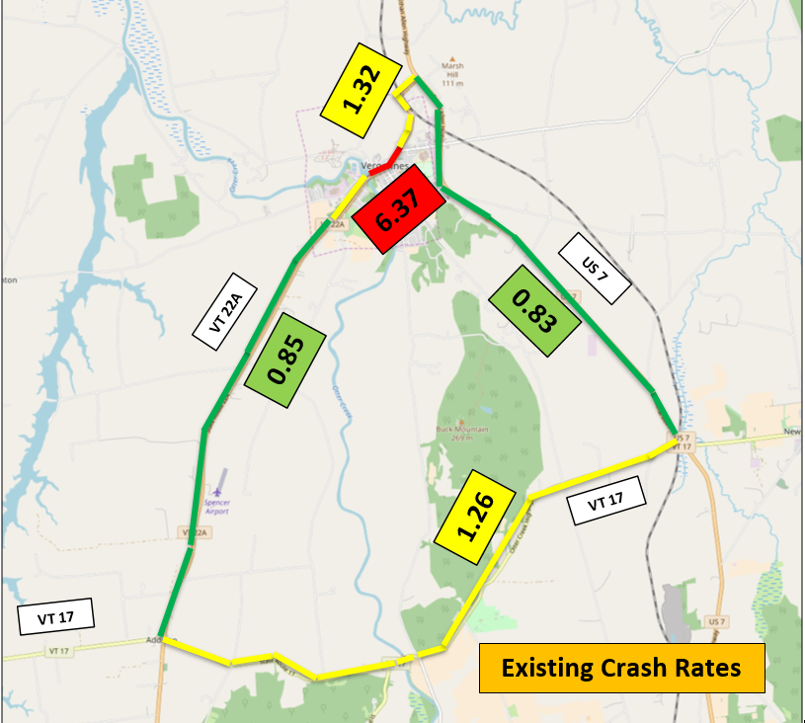
Crash Prediction
Crashes = Volume x Rate x Miles
Notes:
For each alternative action Stantec will need to refine the concept considering existing constraints.
Stantec will also determine the feasibility of each alternative and look at the time frames to develop each alternative.
Finally, a cost-benefit analysis will be prepared for each alternative. The results would be used to compare these proposals to one another and to other transportation projects competing for state funding.

Slide 47
Crash Reduction
Savings | Alt A (In Line) | Alt B (New Alignment) | Alt C (VT 17)
Crashes per Year | Approx. Two | Less than One | Approx. One
Savings per Year | $52,000 | $12,000 | $37,000
Study Area Total (Existing):
41 Crashes per Year
$1.2 Million per Year
Notes:
Each alternative action includes roadway upgrades of some sort resulting in safer roads. When we consider the impacts of these changes on crash rates and the typical cost of crashes we find that each alternative has a positive impact on safety. The savings, estimated at one to two crashes per year compare to 41 crashes per year occurring within the entire study area.

Slide 48
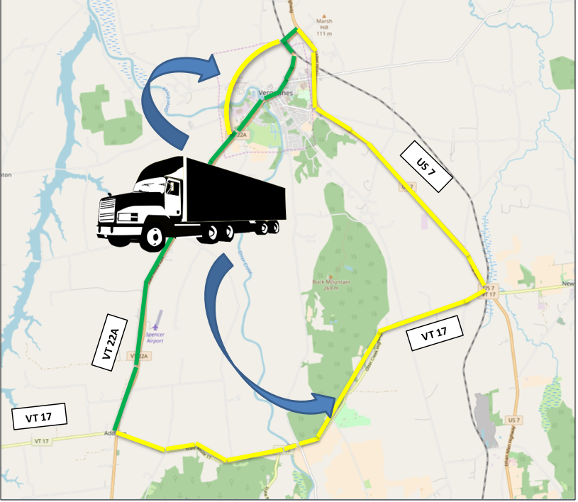
Operational Costs
Notes:
The biggest differentiator among the three alternatives is the impact on truck operating costs. Alts B and C move truck traffic from VT 22A to an alternative route. This impacts travel distances and travel times.

Slide 49
Truck Operations
Impact | Alt A (In Line) | Alt B (New Alignment) | Alt C (VT 17)
Increased Route Length | None | 0.35 Miles | 5.2 Miles
Increased Travel Time | None | Minor | 5.5 Minutes
Added Operating Cost (per Year) | None | $60,000 | $2.2 Million
Truck Operating Cost (Existing):
$3.8 Million per Year
Notes:
For Alt A truck routes and operating costs do not change. Alt B adds to the route length and has little impact on travel times. (Trucks may operate a slightly higher average speeds on the new alignment compared to Main Street.) Alt C however, adds 5.2 miles to the travel distance through the study area and 5.5 minutes to the travel time. This adds $2.2 million to the annual operating cost for trucks passing through the study area, or an increase of approximately 60 percent.

Slide 50
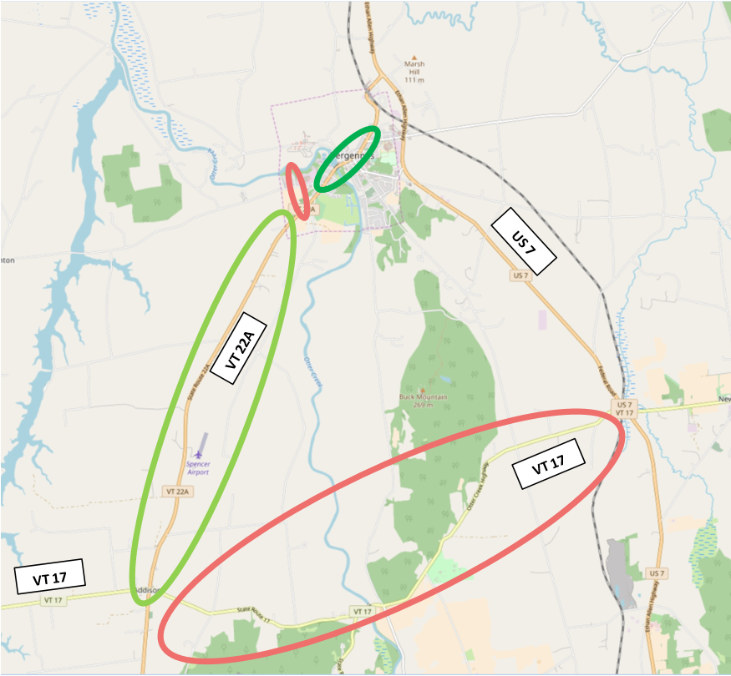
Quality of Life/Economic
Impact Zones
Notes:
Finally, the project impacts from a quality of life and economic perspective in the downtown and other corridors is considered. Generally, Alt B and C remove trucks from downtown and will have a very positive impact there. Likewise, trucks removed from VT 22A outside of the downtown under Alt C also represents a positive impact. However, trucks added to VT 17 have a negative impact to property owners along this roadway. We attempted to quantify these impacts by considering property values and existing levels of economic activity in each of these corridors.

Slide 51
Quality of Life/Economic Impacts
Impact | Alt A (In Line) | Alt B (New Alignment) | Alt C (VT 17)
Downtown Vergennes | Positive | Positive | Positive
VT 22A (Outside of Downtown) | None | None | Positive
VT 17 | None | None | Negative
US 7 | None | None | None
New Alignment | None | Negative | None
Notes:
As stated in our summary, Alts B and C would have significant positive impacts on property values and economic activity in the downtown area. VT 17 residents are negatively impacted by Alt 17 while other residents on VT 22A would see less traffic past their homes with Alt C.. Within the New Alignment corridor some residential properties, farmland and state-owned lands would experience impacts from Alt B.

Slide 52
Comparison Summary
Impact | Alt A (In Line) | Alt B (New Alignment) | Alt C (VT 17)
Downtown Vitality | Minor Change | Major Change | Major Change
Feasibility | Easy | Harder | Moderate
Timing | 1-4 Years | 10+ Years | 8-10 Years
Cost | Low | Higher | High
Safety | Best | Good | Better
Truck Operations | No Change | Minor Change | Major Change
Other Corridors | No Change | Negative Impact | Negative Impact
Notes:
All of the above are summarized in this table allowing for a side-by-side comparison of each alternative. The preponderance of green colors under Alt A suggest that the positive impacts exceed the negative impact for this alternative. Alt B is costly to implement but significantly addresses the project purpose with very limited negative impacts. Alt C also addresses the project purpose but has severe negative impacts on truck operations and unmitigated impacts to property owners on VT 17.

Slide 53
Benefit/Cost Ratio
Impact | Alt A (In Line) | Alt B (New Alignment) | Alt C (VT 17)
Annual Cost | $0.11 Million | $2.7 Million | $1.3 Million
Annual Benefits | $0.12 Million | $0.2 Million | ($2.0) Million
Benefit / Cost Ratio | 1.08 | 0.07 | (1.53)
Notes:
Our study sought to quantify all of the project impacts and benefits from a dollars and cents perspective. Essentially, we monetized all impacts as annual expenses and benefits to calculate a benefit/ cost ratio. When we do this we see a B/C ratio greater than 1.0 for Alt A as the $110K cost of the project will generate $120K in benefits. For Alt B, more significant benefits are realized however the implementation costs are not fully covered. Alt C however, results in a negative benefit stream primarily associated with it’s impact on truck operations.

Slide 54
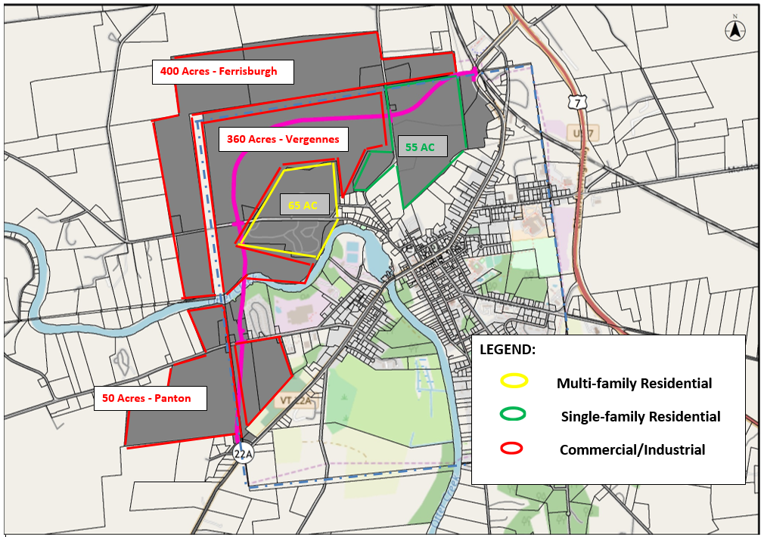
Economic Development - Alt B
Notes:
The benefit / cost calculation for alternative C changes dramatically if the potential impact of this alternative on new economic development is considered. The new roadway would provide access to hundreds of acres land making it ripe for development. Discussions held with representatives of the Vergennes Partnership and City Planning Commission identified a future development scenario for land along the roadway including housing and commercial development. Land values could increase from $23 million to $130 million. Just the new property tax revenues generated by this new development would dramatically impact the benefit / cost calculation.

Slide 55
Benefit/Cost Ratio
Impact | Alt A (In Line) | Alt B (New Alignment) | Alt C (VT 17)
Annual Cost | $0.11 Million | $2.7 Million | $1.3 Million
Annual Benefits | $0.12 Million | $2.8 Million | ($2.0) Million
Benefit / Cost Ratio | 1.08 |  | (1.53)
B/C Modified (Add New Development) |  | 1.03
Notes:
As shown in this slide, if the economic impact of potential new development is considered, Alt B also yields a B/C ratio greater than 1.0.

Slide 56
Agenda
Study Team
Study Overview
Summary Findings
Alternatives Analysis
Recommendations
Next Steps
Discussion

Slide 57
Recommendations
Execute Alternative A (In Line Alternative)
Pursue Alternative B (New Alignment)
Table Alternative C (VT 17)
Notes:
In light of our findings we recommend that you:
Execute Alt A. Work is already underway as the City is actively working with the State to incorporate as much of the plan as possible in the pending paving project.
Pursue Alt B as the most cost effective and most cost-effective approach to addressing the truck issue in Downtown Vergennes.
Table alternative C. Alt C has more negative impacts than positive impacts independent of the project cost.

Slide 58
Agenda
Study Team
Study Overview
Summary Findings
Alternatives Analysis
Recommendations
Next Steps
Discussion

Slide 59

Next Steps
VTrans Capital Plan
  ACRPC TAC Approval
  ACRPC Approval
  Municipal Endorsements
Notes:
As discussed earlier, the next step is to choose and endorse more of more alternative actions. Your comments from this hearing will be provided first to the ACRPC TAC with our final study. Their recommendations may then be reviewed and approved by the ACRPC. Once this has occurred, it is recommended that the governing bodies of all AC communities consider these recommendations and pass resolutions. Again, the goal is to provide unified and clear direction to VTrans. This will influence any VTrans decision to include projects in the capital plan.

Slide 60
VTrans Project Prioritization and Selection Categories
Safety
Mobility/connectivity
Asset condition
Regional importance
Economic access
Flood resilience
Environment
Health access
Notes:
VTrans is still in the process of defining review procedures for large scale projects. They don’t have final procedures yet but do anticipate that all projects will be evaluated against these eight criteria. Stantec finds that the Alt B plan scores well in seven categories.
It removes truck traffic from downtown and would put this traffic on a safer road
It enhances mobility for trucks, allowing them to operate on a roadway designed for trucks.
It provides a second crossing of the Otter Creek in Vergennes which may prove critical when the existing bridge is due for major repairs of replacement
It serves one of the most heavily traveled freight corridor in VT.
It would provide better access to the Job Corps and Collins Aerospace site as well as other properties that may be developed in the future.
Again, it provides a second Otter Creek crossing should flood waters damage the existing crossing.
It removes trucks carrying hazardous materials from a steep grade in downtown Vergennes where a spill could have severe impact on the Otter creek.

Slide 61
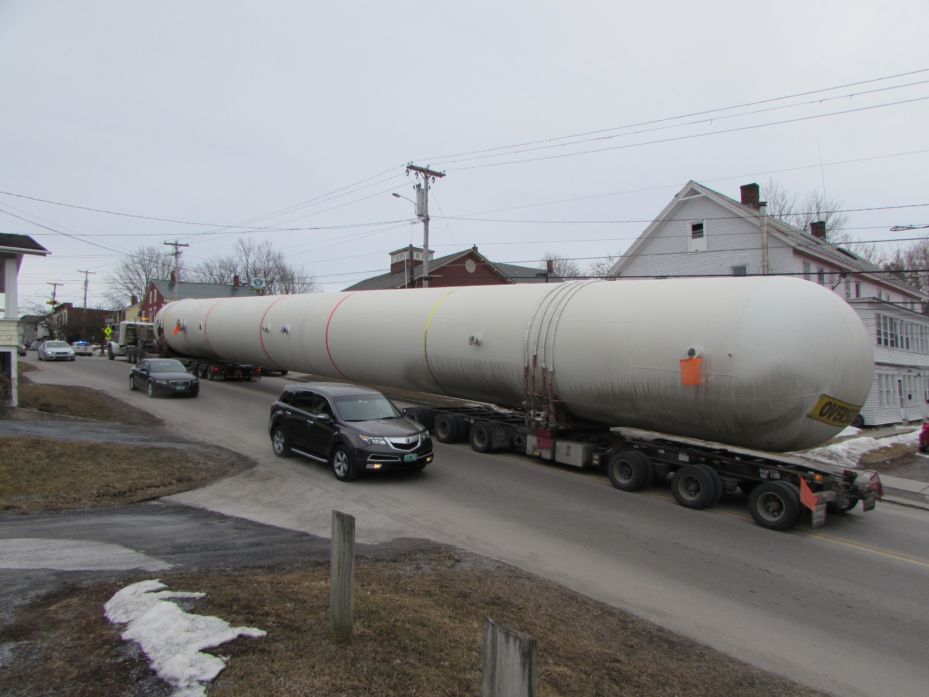
Action Item: Collect Stories
Notes:
This study provided analyses to compare three alternatives to one another. VTrans will need to compare your preferred project or projects to other yet unknow projects around the state when developing its capital plan. You need to prepared to demonstrate how your project meets the criteria listed on the previous slide. You can do this by collecting stories like this one provided to us a few weeks ago. This oversized load got stuck on the uphill grade leading into downtown blocking the roadway for hours. A second bridge, close the downtown, would have provided a less hazardous route for this vehicle or in the alternative an effective detour around the stalled truck.

Slide 62
Agenda
Study Team
Study Overview
Summary Findings
Alternatives Analysis
Recommendations
Next Steps
Discussion

Slide 63
Communications
acrpc.org/programs-services/
transportation/transportation- projects/
Mike Winslow, ACRPC mwinslow@acrpc.org
802 388-3141
Notes:
We’re hear to answer your questions and gather your comments. If you are shy, you can contact us via email at the address given.

Slide 64
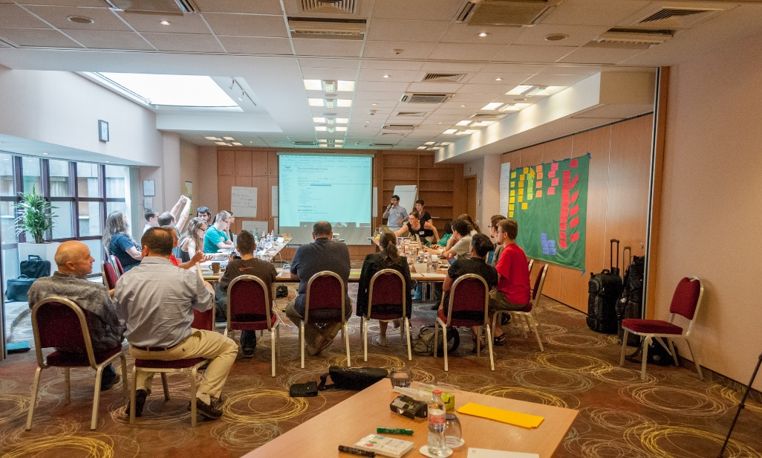
Discussion

